Slide 1
Increasing Representation for Marginalized Artists in America

Slide 2
Christine Toy Johnson
Christine Toy Johnson is an award-winning writer, actor, director, and advocate for inclusion. Her written works have been produced and/or developed across the United States and are included in the Library of Congress’s Asian Pacific American Performing Arts Collection (Playwrights Division). She is an alum of the BMI Musical Theatre Writing Workshop, was a 2016 fellow of The Writers Lab (supported by Meryl Streep, Nicole Kidman, and Oprah Winfrey), serves as Treasurer of the Dramatists Guild and is host of the Guild’s podcast "Talkback" on Broadway Podcast Network. As an actor, Christine has appeared extensively on Broadway, National tours, Off-Broadway, in regional theatres across the country and nearly 100 television and film appearances. Co-founding member of AAPAC (Asian American Performers Action Coalition – 2022 Tony Honors for Excellence in the Theatre, 2020 Special Obie Citation for Advocacy), and founder of the Asian American Theatre Artists Collective. Recipient of Rosetta LeNoire, JACL, Asian American Arts Alliance awards for advocacy in diversity and inclusion as well as 25 grant awards in support of her work. For details, please visit www.christinetoyjohnson.com

Slide 3
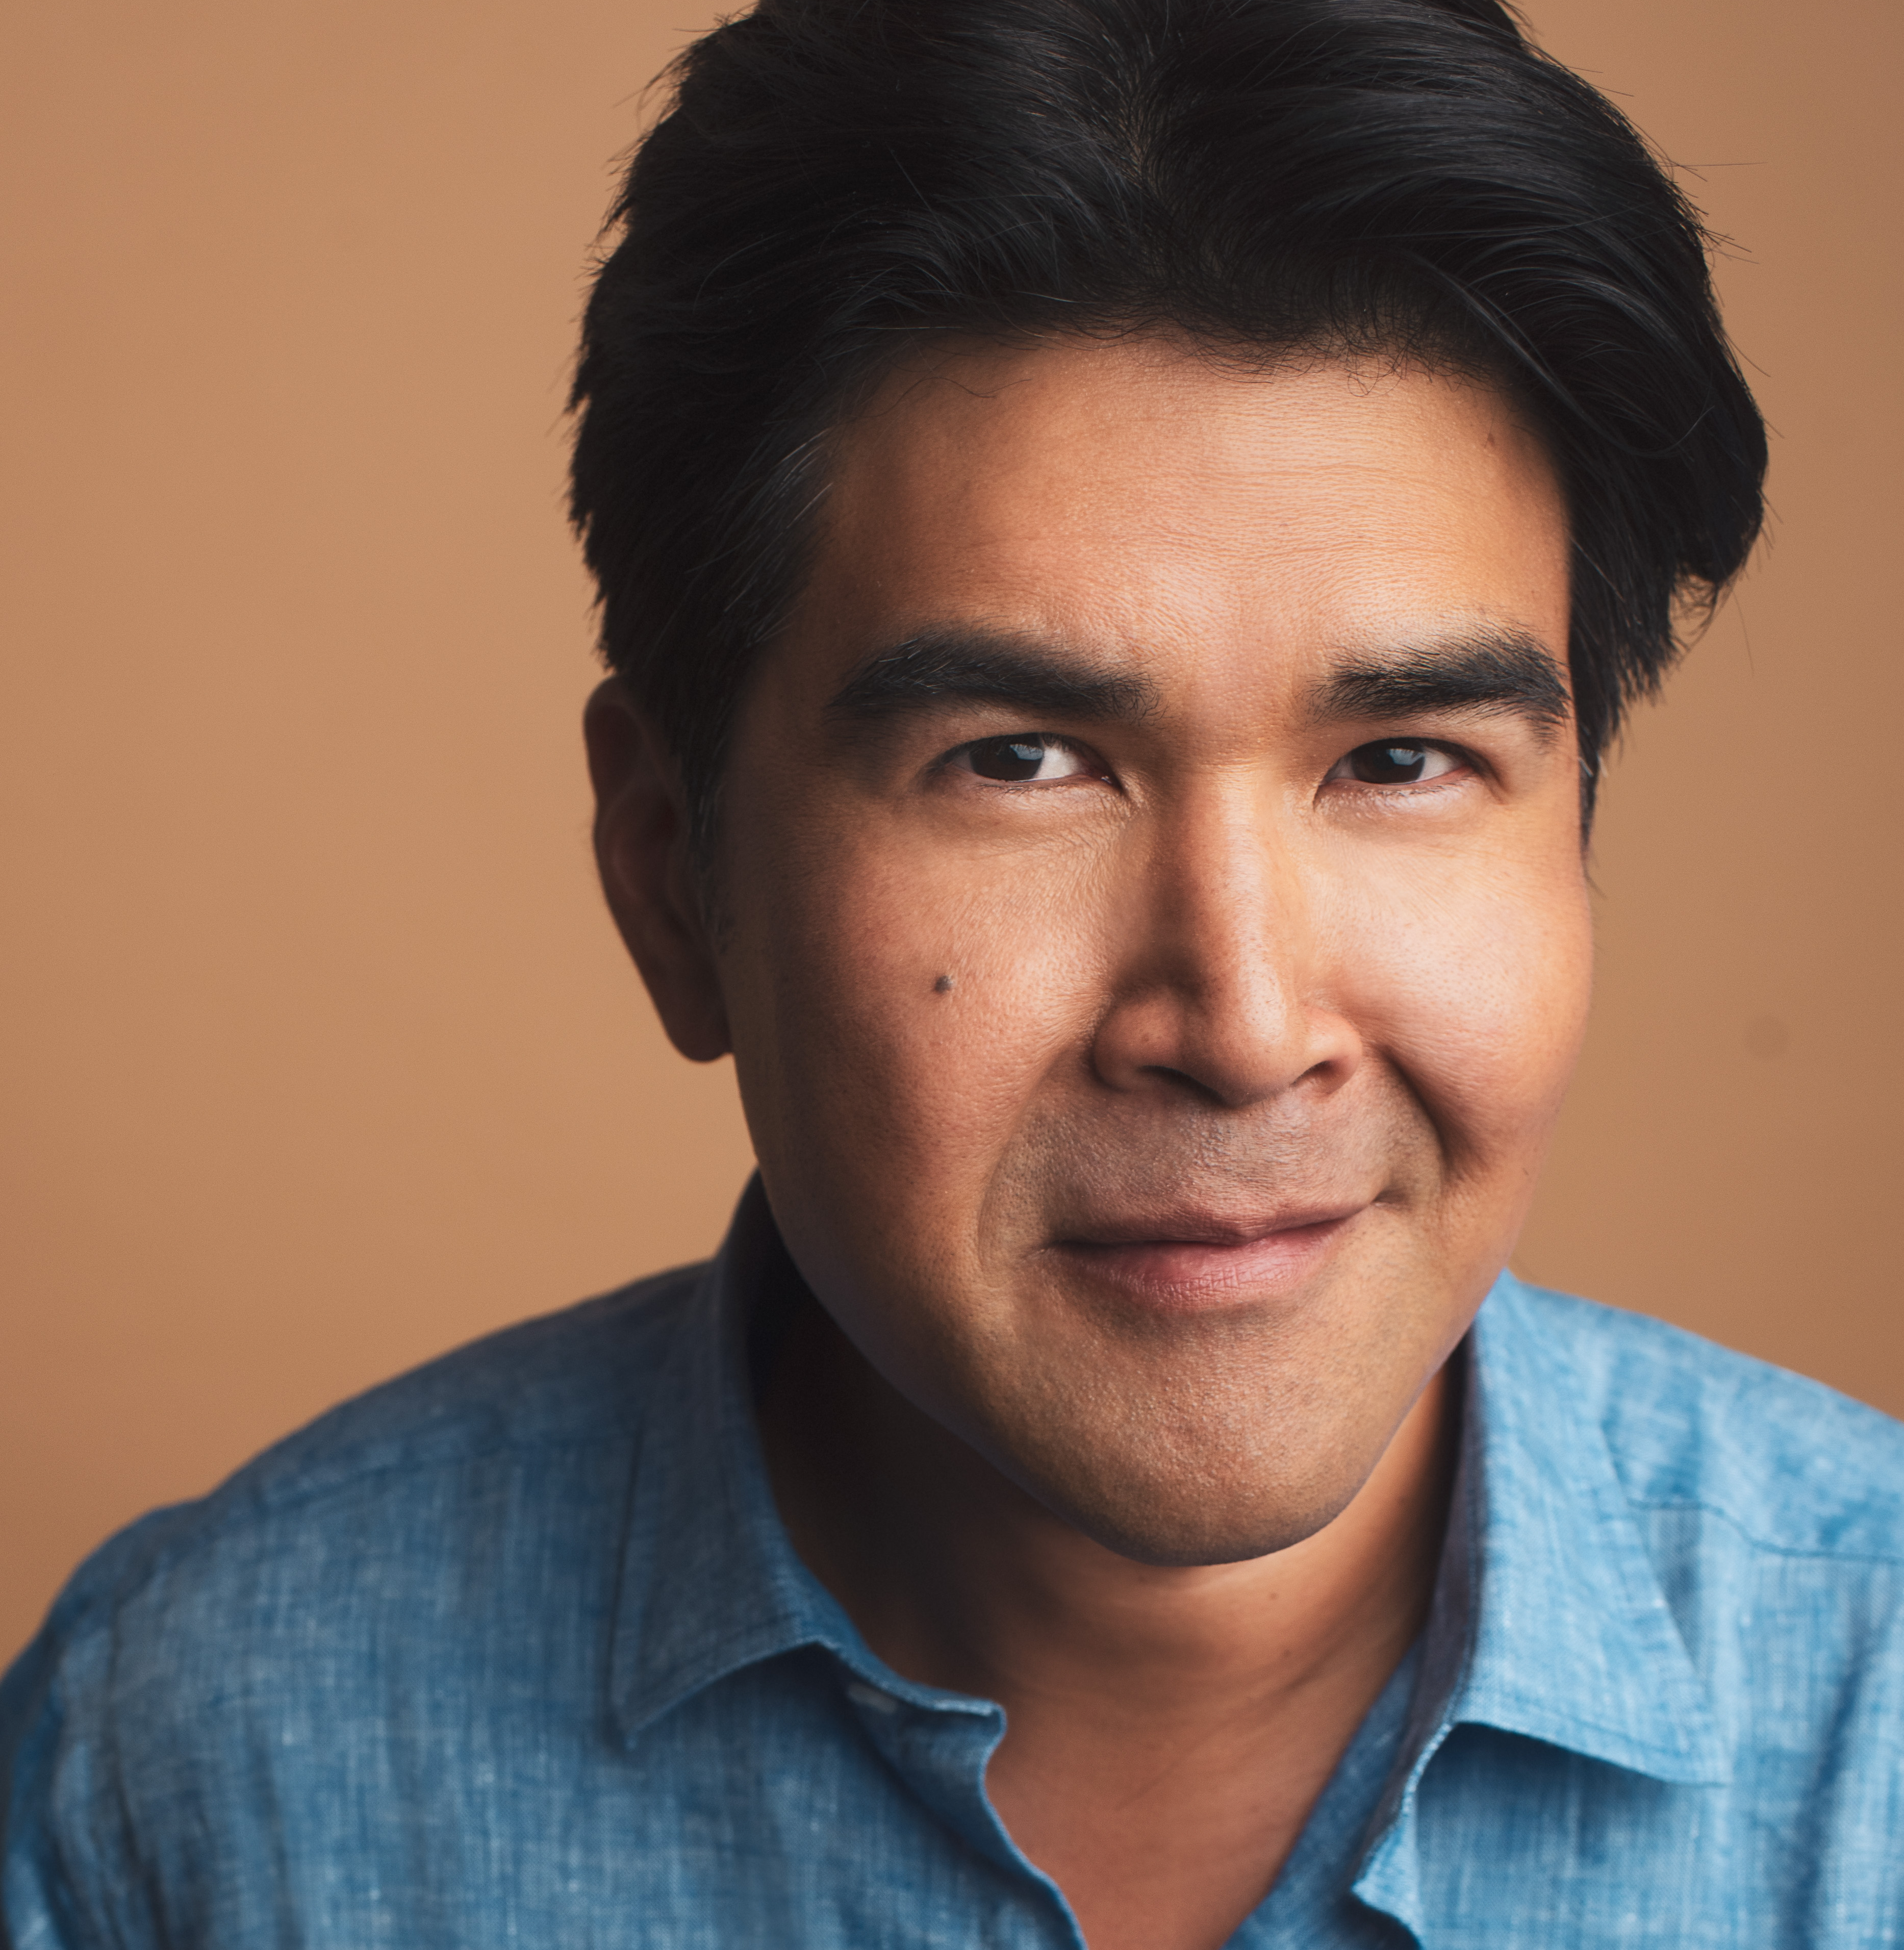
Pun Bandhu
Pun Bandhu is an award-winning actor who has worked on Broadway, Off Broadway, in TV and Film. He can be seen in the Oscar-nominated films Michael Clayton, Burn After Reading, Frozen River and Can You Ever Forgive Me? among others. In TV, he has guest starred on NCIS: New Orleans, Gotham, Difficult People, Orange Is The New Black, FBI, Madam Secretary, Blind Spot and recurred on Blue Bloods among many others. He is the recipient of The Bowden Actor Award from New Dramatists and a Henry Award for Best Supporting Actor. Pun is also one of the first Broadway producers of Asian descent to receive multiple Tony Awards for producing the first revival of Glengarry Glen Ross (2005) and the original musical Spring Awakening (2007). Lastly, in addition to his work as an artist, Pun is also a passionate advocate. He is the recipient of an Obie Award and a Tony Honor as a co-founder of the Asian American Performers Action Coalition, awarded in recognition of the group's impact in increasing diversity for artists of color over the last decade. Pun has been brought in as a guest speaker at numerous colleges and institutions to speak about the intersection of race and the arts and is often quoted in periodicals. He serves as a nominator for the Tony Awards and is on the Advisory Board for the Yale School of Drama, where he received his MFA in Acting. www.punbandhu.com
Caption

Slide 4
Nandita Shenoy
Nandita Shenoy is a New York-based writer-actor who loves hearing an audience laugh. Her play The Future Is Female… received its world premiere at the Flint Repertory Theater last winter. It was a Finalist for the O’Neill National Playwrights Conference, and her Rage Play was named to the 2020 Kilroys List. Her Washer/Dryer has been produced multiple times nationally after its world premiere at LA’s East West Players and an Off-Broadway production in which she also starred. Her first full-length, Lyme Park: An Austonian Romance of an Indian Nature, was produced by theHegira in Washington, DC, and Satisfaction had a developmental run at the American Academy of Dramatic Arts. One-acts, Marrying Nandini, By Popular Demand, Rules of Engagement, You Are Here, and A More Perfect Date have been produced in New York City and regionally. Nandita has acted in world premiers of new plays by Richard Dresser, Madhuri Shekar, Chelsea Marcantel, Adam Szymkowicz, and Eric Pfeffinger as well as a season at the Alabama Shakespeare Festival. Nandita won the 2014 Father Hamblin Award in Playwriting, a 2018 Mellon Creative Research Fellowship at the University of Washington School of Drama in partnership with Ma-Yi Theater Company, and 2022 Hermitage Fellowship. She is a proud member of the Ma-Yi Writers Lab, dtfwaw, and the Dramatists Guild as well as Actors Equity and SAG-AFTRA. She sits on the Steering Committee of the Asian American Performers Action Coalition (AAPAC) which received Tony Honor for Excellence in Theater last year. Nandita holds a BA in English literature from Yale University. www.nanditashenoy.com

Slide 5
ster·e·o·type
/ˈsterēəˌtīp/
noun
1. a widely held but fixed and oversimplified image or idea of a particular type of person or thing.

Slide 6
Video: BEYOND ORIENTALISM

Slide 7
Artists on the Margins
What is the compounded effect on a group of people when those in the mainstream only view you based on your stereotypes?
How does bias or racism affect your career opportunities and what you are able to do?
How can artists change how they are perceived?
How can underrepresented artists empower themselves and their communities?

Slide 8
Self-Empowerment and Shifting Perspectives: The Power of Data
How often are we aware of our own oppression?
What role can data play in activating a group of people?
How can data be used to reveal structural racism?
How can knowledge be used to shift perspectives?

Slide 10
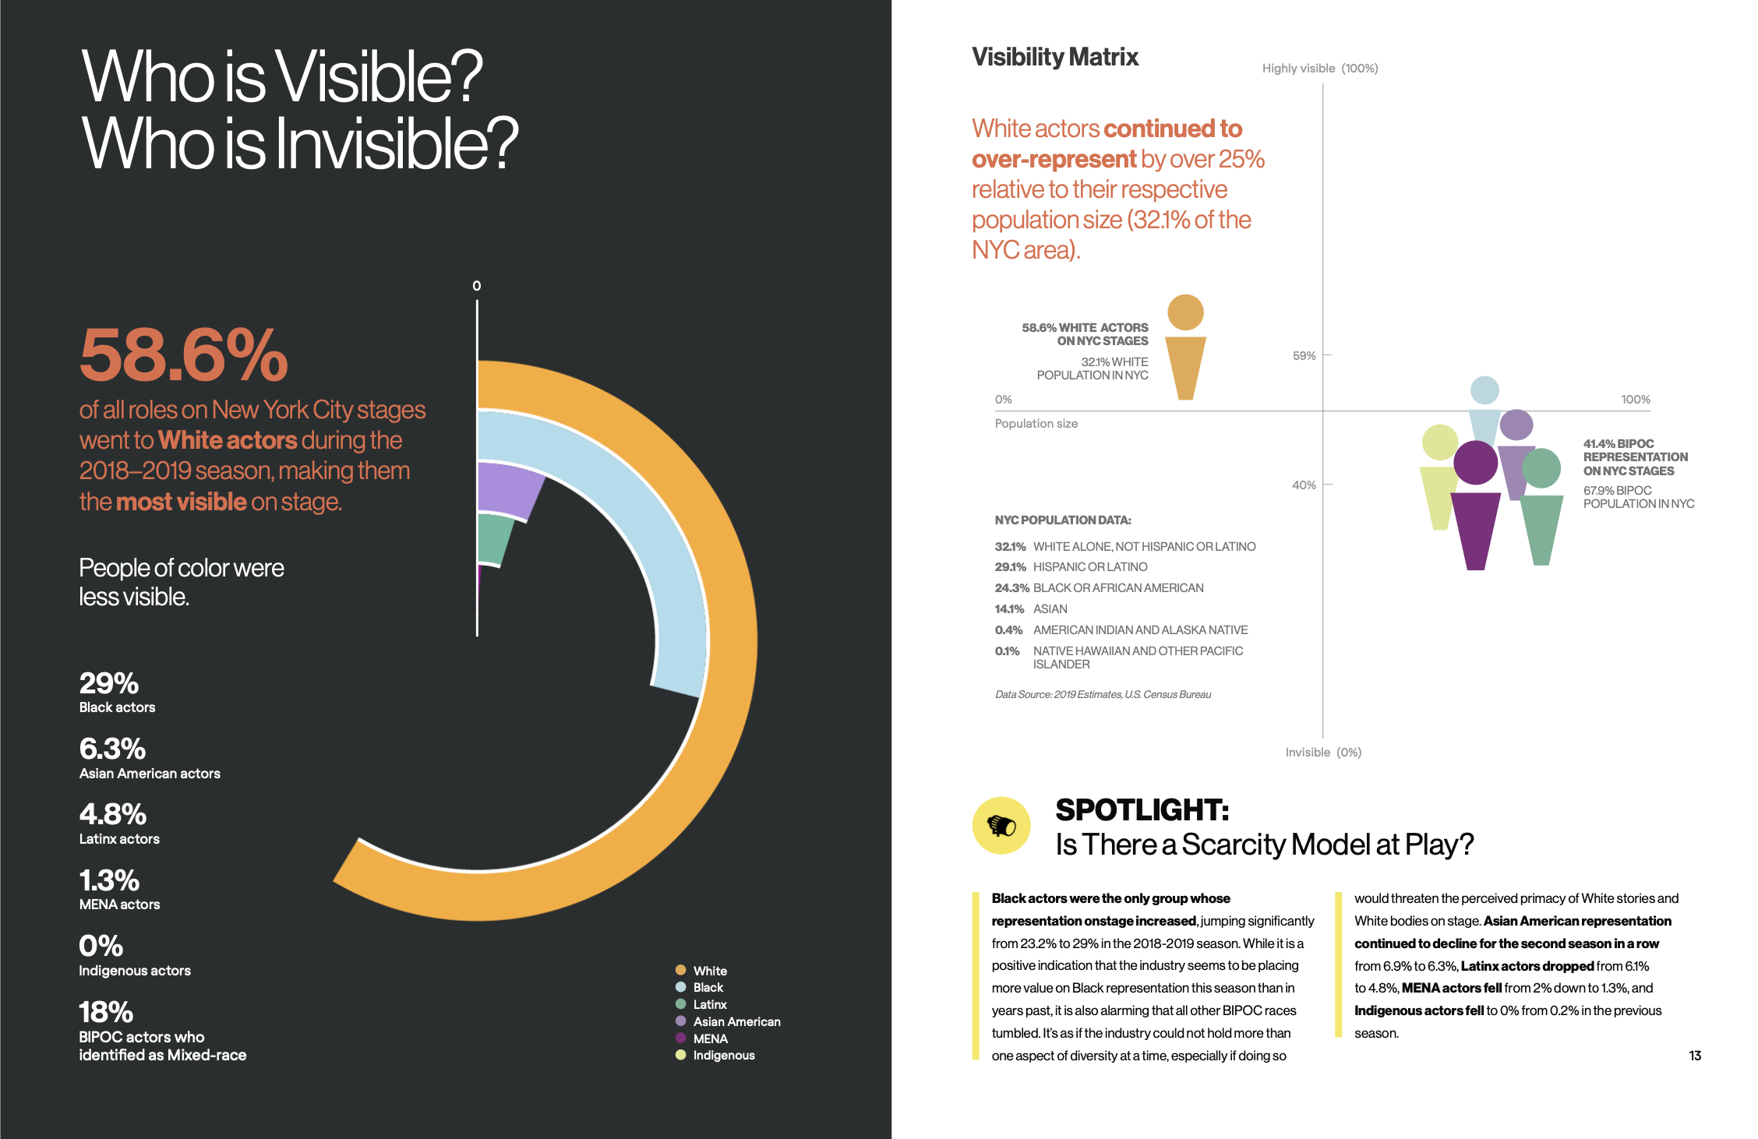

Slide 13
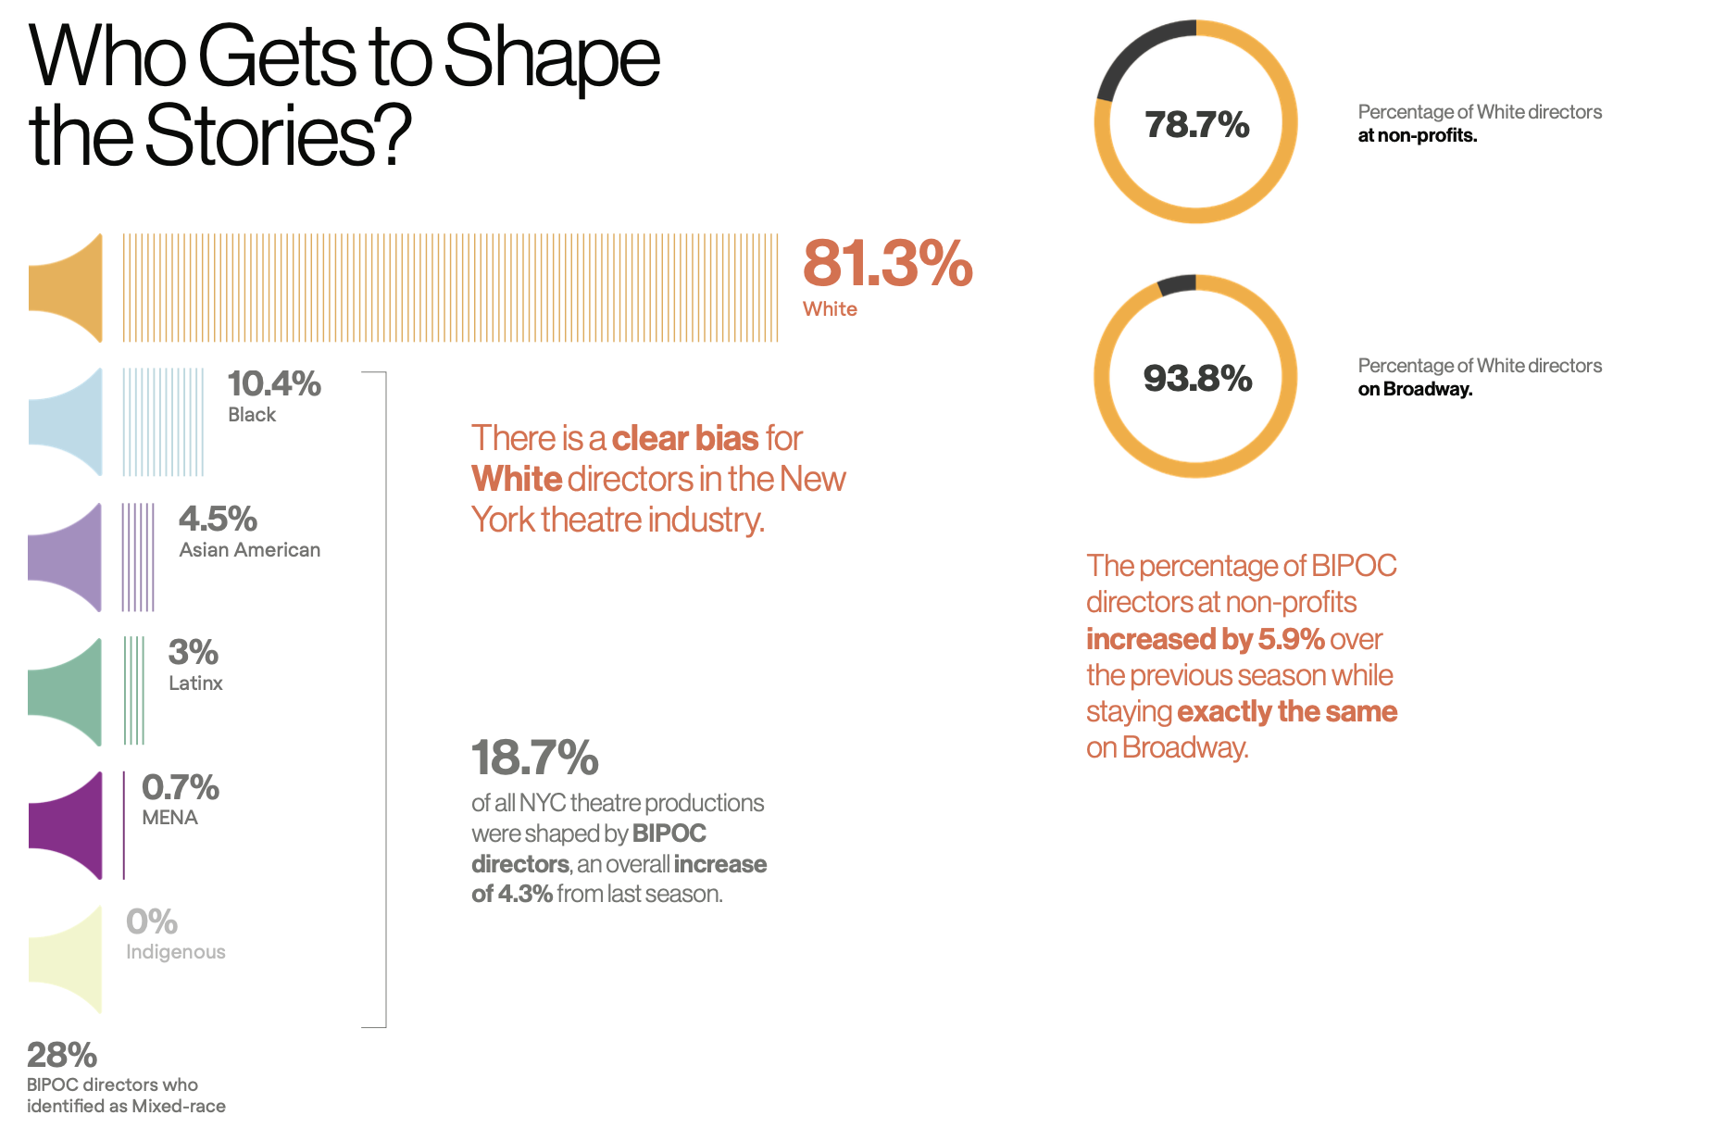

Slide 14
How to Transform the Theatre Industry ;
The AAPAC Case Study

Slide 15
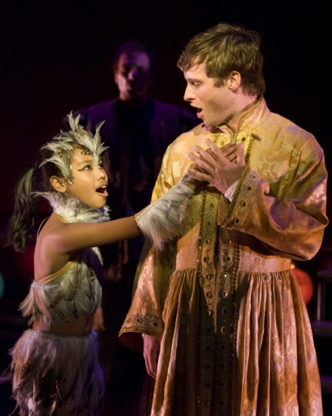
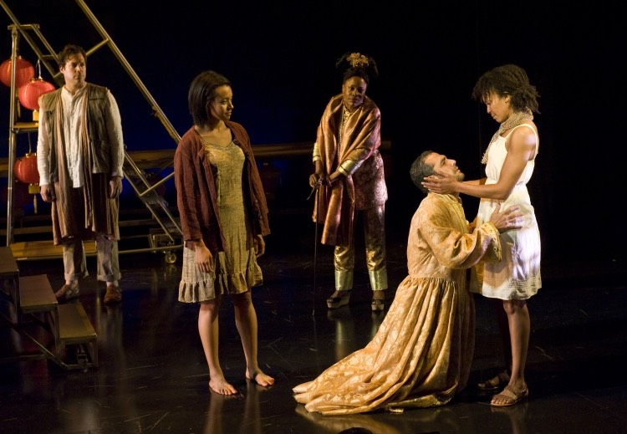
The Nightingale
La Jolla Playhouse, 2012
An example of how “inclusion” may look different for those in the dominant group vs those who have been systematically excluded.
“It’s a mythical China.” -Director Moises Kaufman
“We had a workshop that was fully Asian, and it’s not appropriate to the piece. It’s not about Asia.”-Composer Duncan Sheik

Slide 16
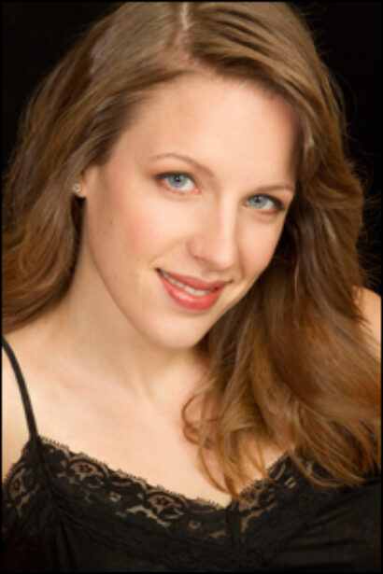
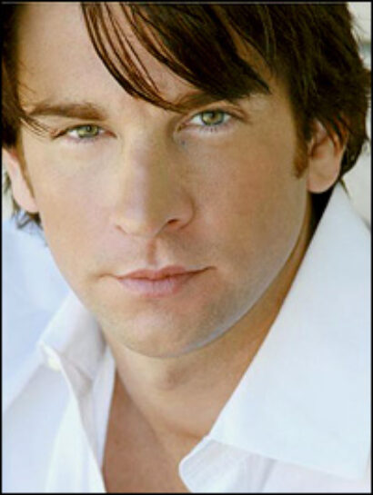
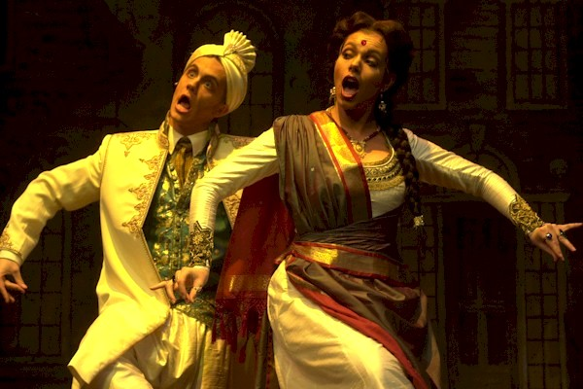
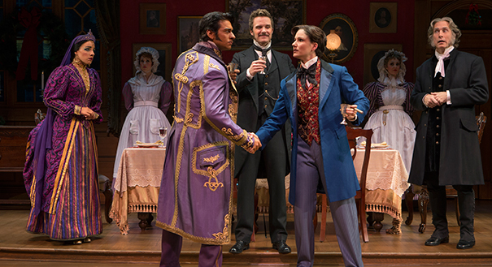
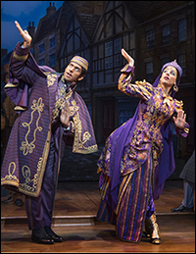
The Mystery of Edwin Drood
Roundabout Theatre Co, Broadway 2013

Slide 17
Yellow Face Casting
Why does it continue to happen?
What are the underlying belief structures behind it?
How does its continued use foster a system of white supremacy?
How does it impact Asians? The art form?

Slide 18
Questions and Discussion

